Slide 1
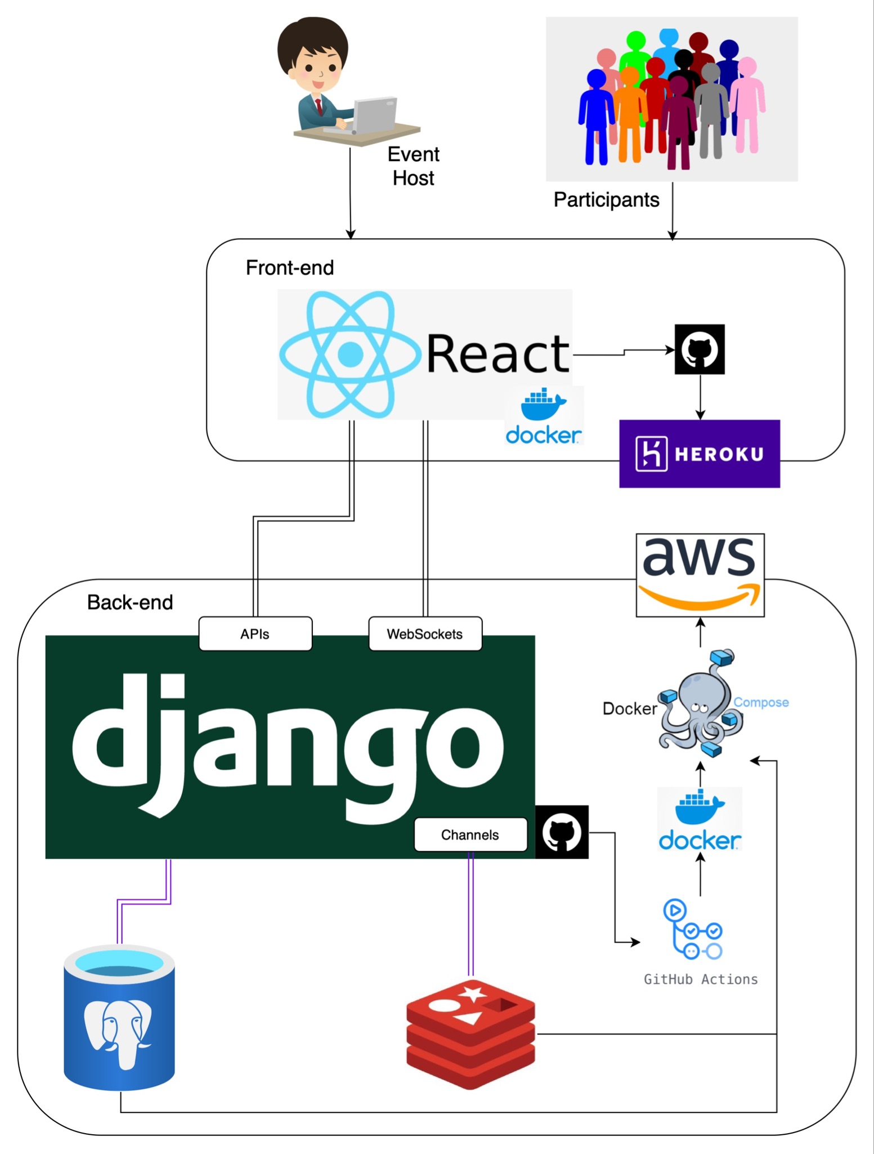




Empathy Walk
CHALLENGES
- Tight deadlines
- Estimating tasks and handling edge cases
- Vague requirement specifications
- Changes or modifications in requirements
- Last-Minute Defects and Escalated Issues
LEARNINGS
- Breaking down tasks into smaller chunks
- Starting small and then extending it to other edge cases
- Confirming assumptions with clients
- Importance of documentation
- Automated tests
- Test every piece of code
- Change one thing at a time with Pull Requests
TECH
STACK
&
Do it live from Anywhere
Be anonymous

